Slide 1

Predictive Analysis of Movies on OTT platforms Using Machine learning Approach (Track01-177)
-By Devesh Shetty

Slide 2
Index
Abstract
Introduction
Problem Statement
Scope
Platform
Overview of the System
Implementation
Implementation & Results
Comparative study
Conclusion
Future Scope
References

Slide 3
Abstract
Movies are considered to be an important art forms, a worldwide source of entertainment, and a powerful medium for educating or indoctrinating citizens. As far as the current pandemic situation is concerned, OTT platforms act as one of the most entertaining factors and a significant stress reliever for people around the globe.
This project aims to explore all the movies in popular OTT platforms, in order to gain interesting insights. This is carried out with the aid of a Kaggle dataset, collected from Netflix, Prime Video, Hulu and Disney+ .
Dataset contains the complete information of all the movies, their ratings and the corresponding OTT platforms in which they are available. It provides detailed information such as Year of release, Genre, IMDb rating, Director and the Language of each movie.
In this project, we are evaluating our data and attempting to derive meaningful insights from data obtained from Netflix, Prime Video, Hulu, and Disney+ OTT platforms. In addition, the results of these algorithms are compared in order to determine their applicability and efficiency under various scenarios.

Slide 4
Introduction
Movies are essential art forms and a global source of entertainment. OTT platforms are one of the most enjoyable reasons since people all over the world may watch movies they like without commercials.
Here the data is analysed and some visualization and manipulation are carried to get a more precise and a graphical picture of the entire dataset. The Dataset Obtained is from kaggle and has around 16,744 lines of data collected from various OTT platforms.
We also use techniques like Multiple linear regression and Random forest to analyze our data and derive predictive and interesting insights from the information gathered from various OTTs based on ratings and other independent factors.

Slide 5
Problem Statement
These days, technology has got its new and higher pace. This development has changed human’s way of watching or consuming content now people can also rate the content or movie according to their views about the movies their opinions, sentiments and views can be expressed on various platforms like IMDb, Rotten Tomatoes in which they do so these review and rating platforms are nothing but a way through which people express their thoughts or views regarding the movie. The platforms like IMDb, Rotten Tomatoes will help people to express and others to judge the movie based on the review of people. So to check how ratings are affected by other factors like runtime, directors etc. there is a need of technique which is required to basically process and analyze the data,
Here Based on the dataset obtained from kaggle we can further process the data depending upon the data we can find possible ways to do this. R is an open-source

Slide 6

Scope
Analyzing the Movie data is important for many applications such as OTT platforms trying to find out the response of their movies in the market, predicting popularity of the movie. Pushing movies on platforms based on the current trends in the market.
This Analysis on Movie Dataset has a number of applications:
Business: OTT platforms like Netflix, Prime Video, Hulu and Disney+ they all use this data to judge the popularity of the movie based on the current trends and thus helps them get insights and push such movies.
Recommendation: Recommendation is one of the most important and popular techniques to engage users with their content and this is what OTT platforms look for and through this insights they can easily help them recommend.
Reviews :These reviews and rating can help us understand the how the movie is and we get to decide whether to go for it or not.

Slide 7
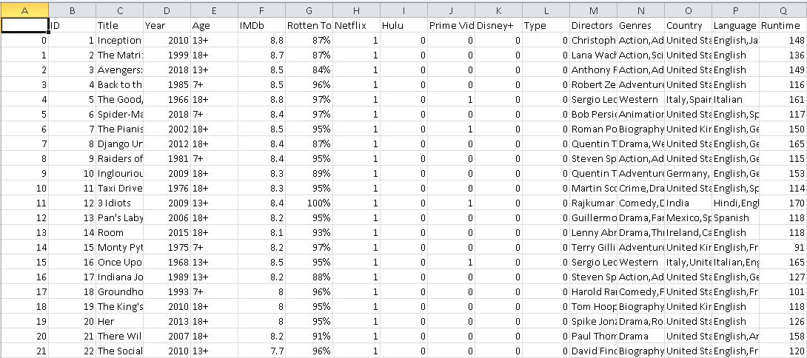
Platform
Dataset

Slide 8

Platform (Cont.)
The dataset used here is obtained from kaggle it consists around 16,744 rows in total.
The dataset used here basically consists detail about movies like its Streaming service, Rating, Genres it belong to, Directors etc. related to the movie.
This data was cleaned and further duplicate values were removed so that accuracy of data is maintained and is not disturbed due to presence of null or NA values. After cleaning and removal we got around 15,819 rows in total which was further used for processes.

Slide 9
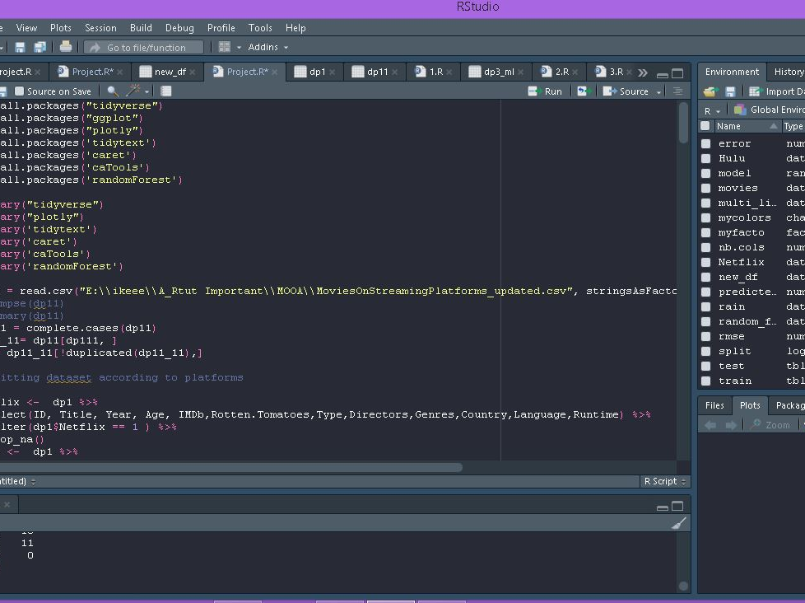
Platform (Cont.)
R-Studio:

Slide 10
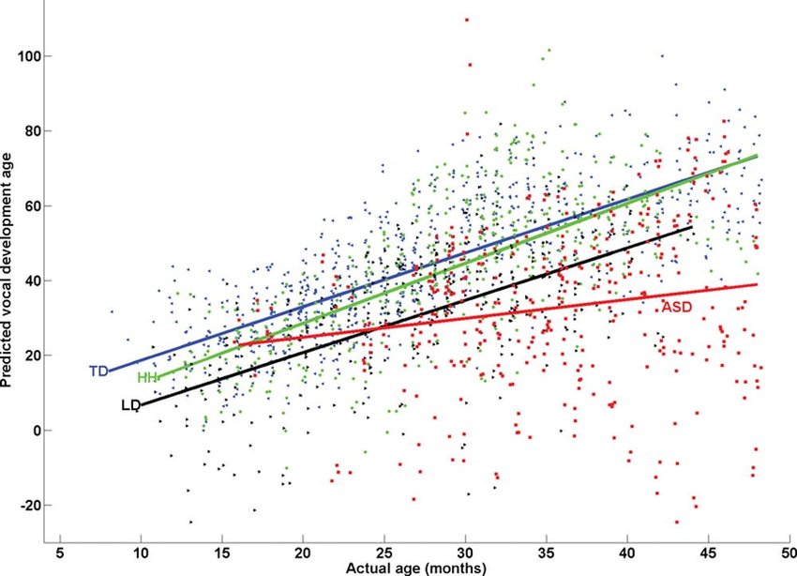
Overview of the System
Multiple Linear Regression
Multiple linear regression (MLR) is a statistical technique that uses several explanatory variables to predict the outcome of a response variable.
The goal of multiple linear regression (MLR) is to model the linear relationship between the explanatory (independent) variables and response (dependent) variable.
Multiple regression is an extension of linear (OLS) regression that uses just one explanatory variable.
Formula :yi​=β0​+β1​xi1​+β2​xi2​+...+βp​xip​+ϵ

Slide 11
Overview of the System (Cont.)
Random Forest
Random Forest is a popular machine learning algorithm that belongs to the supervised learning technique. It can be used for both Classification and Regression problems in ML. It is based on the concept of ensemble learning, which is a process of combining multiple classifiers to solve a complex problem and to improve the performance of the model.
As the name suggests, "Random Forest is a classifier that contains a number of decision trees on various subsets of the given dataset and takes the average to improve the predictive accuracy of that dataset." Instead of relying on one decision tree, the random forest takes the prediction from each tree and based on the majority votes of predictions, and it predicts the final output.
The greater number of trees in the forest leads to higher accuracy and prevents the problem of over fitting.

Slide 12
Implementation
Here as mentioned in the previous slides after cleaning and data pre processing we got around 15,819 rows.
After this we did performed data manipulation and data visualization to represent the data in a graphical format.
For applying Multiple Linear regression and Random forest we are considering IMDb ratings as dependent on various independent values such as Age, Runtime, Year, Genres.
Based on these independent values a predicted value is generated for the algorithms that they are applied on and also a root mean error is generated for the algorithms.

Slide 13
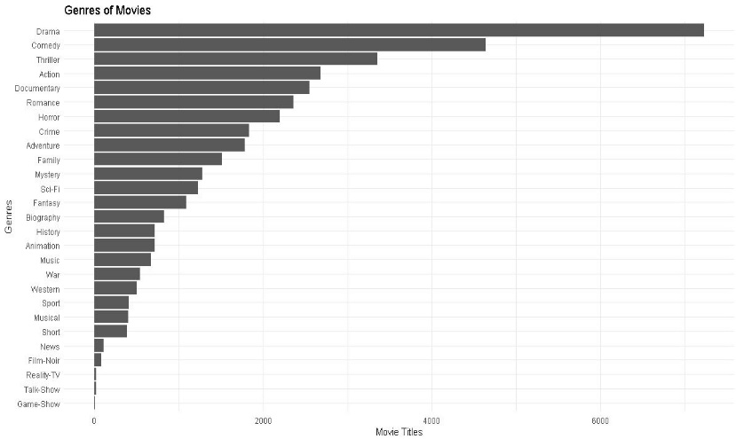
Implementation (Cont.)
Data Visualization

Slide 14
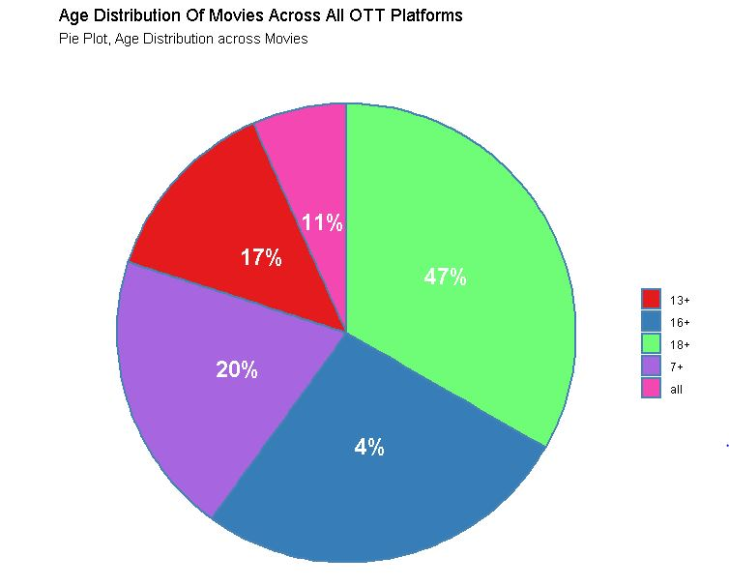
Implementation (Cont.)
Data Visualization

Slide 15
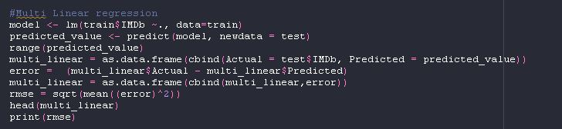
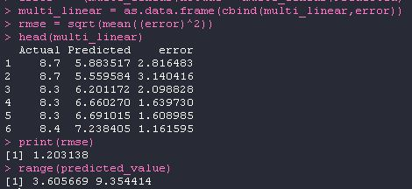
Implementation & Results
Multiple Linear Regression
Output:

Slide 16
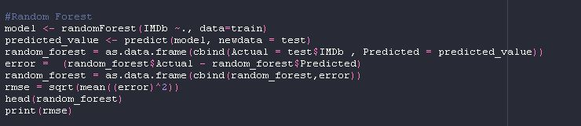
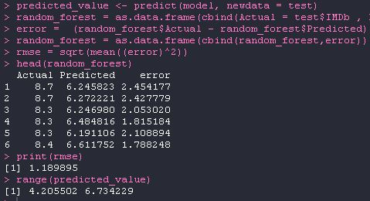
Implementation & Results
Random Forest
Output

Slide 17
Comparative study
Comparison of Two Algorithms
The comparison of both algorithm through results can give us a better understanding about their accuracy and usefulness within the project. The output 1 which is for Multiple Linear regression gives us the actual value along with predicted and error value. The root mean square error is 1.203138 here.
In Output 2 which is for Random Forest it gives us the actual value along with predicted and error value. The root mean square error is 1.186786 here.
Since 1.203138 > 1.186786
Hence from here from the root mean square error we can judge that the Random forest algorithm is much more accurate and efficient as compared to the Multiple linear regression.

Slide 18
Comparative study
MLR Output 1:
RF Output 2:

Slide 19
Conclusion
Herein, I after cleaning and removing duplicate values from data analyzed the data with respect to its IMDb ratings which I predicted using many other independent parameters .
The aim of this experiment was movies on OTT analysis wherein I predict the IMDb ratings based on various other parameters using Multiple Linear Regression Algorithm and Random Forest Algorithm.
For the data we used kaggle which provided us with the data the data was around 16,744 which was later processed and manipulated to get meaning full insights .From results It is clear that the accuracy of Random Forest Algorithm with root mean square error = 1.186786 is a bit higher as compared to Multiple Linear Regression Algorithm with root mean square error = 1.203138 but as the data will increase the accuracy of the algorithms will also change. Hence the addition of more data will help us in better prediction for actual values.

Slide 20
Future Scope
The Existing Database is of around 16k data which is not sufficient to get meaningful insights from the data that accurately .
Also, this type of database is limited for processing of structured data and has a limitation when dealing with a large amount of data. So, the use of Big Data technologies like Hadoop can be used to achieve better results.
We could further improve our analysis by using various different algorithms and see which gives us better accuracy.

Slide 21
References
Yasen, M., & Tedmori, S. (2019). Movies Reviews Sentiment Analysis and Classification. 2019 IEEE Jordan International Joint Conference on Electrical Engineering and Information Technology (JEEIT). doi:10.1109/jeeit.2019.8717422.
Kayri, M., Kayri, I., & Gencoglu, M. T. (2017). The performance comparison of Multiple Linear Regression, Random Forest and Artificial Neural Network by using photovoltaic and atmospheric data. 2017 14th International Conference on Engineering of Modern Electric Systems (EMES). doi:10.1109/emes.2017.7980368
Prof Ria Patnaik, Prof Reema Shah, Prof Upendra More, Rise of OTT Platforms: Effect of the C-19 Pandemic, -- Palarch’s Journal Of Archaeology Of Egypt/Egyptology 18(7). ISSN 1567-214x
Song, Minzheong A Comparative Study on Over-The-Tops, Netflix & Amazon Prime Video: Based on the Success Factors of Innovation -International Journal of Advanced Smart Convergence Vol.10 No.1 62-74 (2021)

Slide 22

Thank You

